Slide 1
Philosophy of Engineering
Unit - 4
Methodology of Engineering
Difference between Scientific Method and Engineering Design (ADDIE)- CDIO Engineers in Industry - Conceive and Design - Engineering Design Process - Implement and Operate - Operational Factors in System Design -
Practice 10: Relate ADDIE and CDIO Methodology
Practice 11: Illustrate the Engineering Design Process for the given Application
Practice 12: Analyze the Requirements of Operational Engineers
Prepared by
Dr. M . Vikneswaran
Assistant Professor, Mechanical Engineering, SRMIST, Ramapuram

Slide 2
DIFFERENCE BETWEEN SCIENTIFIC METHOD AND ENGINEERING DESIGN
Scientists study how nature works and discover new knowledge about the universe,
Engineers create or construct new things, such as products, websites, environments, and experiences.
Because engineers and scientists have different objectives, they follow different processes in their work.
Scientists perform experiments using the scientific method.
Engineers follow the creativity-based engineering design process.

Slide 3
DIFFERENCE BETWEEN SCIENTIFIC METHOD AND ENGINEERING DESIGN
Both scientists and engineers contribute to the world of human knowledge, but in different ways.
Scientists use the scientific method to make testable explanations and predictions about the world.
A scientist asks a question and develops an experiment, or set of experiments, to answer that question.
Engineers use the engineering design process to create solutions to problems.
An engineer identifies a specific need: Who need(s) what because why? And then, he or she creates a solution that meets the need

Slide 4
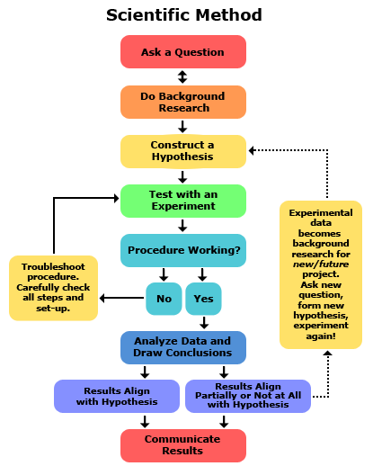
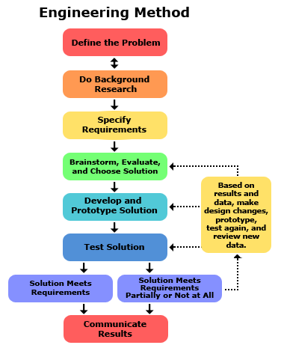
DIFFERENCE BETWEEN SCIENTIFIC METHOD AND ENGINEERING DESIGN

Slide 5
https://www.youtube.com/watch?v=JZdv5lrJs4U&list=PL20E84CD77B301A20
ADDIE MODEL:
Analysis > Design > Development > Implementation > Evaluation
ADDIE is a leading learning development model used for instructional design, which is the complete process of designing, developing, and serving learning content.
The model is often used to design training and learning & development programs in organizations.
The ADDIE training model provides a streamlined, structured framework that helps you create an effective learning product, whether that’s delivered through an online or offline training program, a coaching session, a presentation, or an information booklet.
ADDIE helps identify the learning need in a structured way and ensures all learning activities serve that goal, which offers an integrated approach to learning.
It also guides measuring learning effectiveness because job behaviors, knowledge, and skills are clearly defined within the framework.

Slide 6
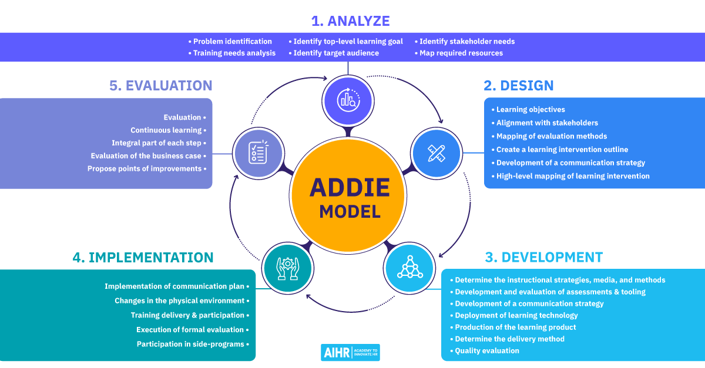

Slide 7
Analyze:
Step 1: Identify the problem to solve. (For example, maybe it’s poor sales, a non-inclusive culture, or a lack of skills to move to a more digitized organization).
Step 2: Decide whether it can be solved through effective training courses or other organizational development interventions will be more effective.
Step 3: Identify the target audience. (Who is the audience?)
Step 4: Before developing an effective course, first asses the current knowledge, skills, and background of the audience to find out the gaps that need to be filled. Use the training needs analysis (TNA) process to identify the gap between the existing and desired skills, knowledge, and abilities.
Step 5: By finding the gaps, Define the learning goals and objectives of the course (ex., After completion of this course, the audience can able to “Demonstrate, Describe, Explain, etc.) – this helps guide the content development process and ensures that learners are achieving their desired learning outcomes
Step 6: Based on all the information gathered, map out the resources required for the training - include the number of training hours, duration, required budget, facilities, and additional information.
Step 7: Once all of the information are collected, create a full training plan, which will include the who, what, when, where, why, and how of the training.

Slide 8
Design: Translate Analyze phase → learning design.
The design phase deals with learning objectives, assessment instruments, exercises, content, subject matter analysis, lesson planning, and media selection.
Here are some questions that should be answered during the design phase:
How will the content and activities be sequenced, presented, and reinforced?
What are the objectives of each session/unit?
What skills or outcomes are you hoping to achieve for each?
What methodology will you use to achieve each objective?
What media/resources will be used in the instruction?
How will you assess the students’ understanding of the material?
This phase is often time-intensive and requires attention to detail.
This will include strategy, delivery methods (e.g., online, offline, blended), lessons, duration, assessment, and feedback.
Guides to design
Learning intervention for each workshop or lesson.
Specific learning objectives for each workshop or lesson,
Structure of the content,
Mental processes needed by participants, knowledge or skills participants need to retain,
Best tools to use, videos or graphics, ppt to create,
Length of time for each lesson.

Slide 9
Development Phase: Create and Assemble the content assets that were blueprinted in the design phase.
In this phase, storyboards are created, content is written, graphics, recording videos, and carefully selecting fonts and colors are designed.
If e-learning is involved, programmers work to develop and/or integrate technologies, (what software and tools will need (e.g.,) video conferencing software like Zoom, vendor’s platform, or an LMS).
Once the course is created, test for errors like grammar and spelling and ease of navigation to ensure content accuracy and utility of navigation.
Identify tools (online survey platform) to evaluate the training - Is your learner able to progress through the course in the way you designed? Is it engaging? What is the duration like?
During the development phase, these questions should be answered:
How do I create a lesson plan
How should the content be organized
What instructor and student activities should be included
How do I provide practice for students
What media should I use when teaching
How can I take corrective feedback

Slide 10
Implement Phase: Focuses on the delivery of the training and project management.
The facilitators’ training should cover the course curriculum, learning outcomes, methods of delivery, and testing procedures.
The training delivery is the key element in this phase.
Are there any extra guides or manuals the learners need?
What is the protocol if users experience technical difficulties during the training?
It’s a sensible idea to have additional IT support on hand and let learners know who to contact.
These questions should be answered when carrying out the implementation phase:
How do I motivate students
How do I introduce the lesson
What kinds of questions are best to use
How do I use PowerPoint slides or other presentation media
How do I summarize and review each lesson or presentation
How do I use my time wisely during the lesson

Slide 11
Evaluation - makes sure - Is the course effective? Are your learners confused?
Evaluation objectives reflect much of the discoveries found in the Analysis process.
These discoveries include the objectives and expectations of the learner.
The evaluation phase is about gathering important information to see if the course needs to be revised and improved.
Gather this information by viewing back-end data on the LMS.
Asking users to complete surveys after they’ve finished the course.
Then plop it right back into the beginning Analysis phase, which starts an entirely new iteration of your end-product.
Here are some questions that should be answered during the evaluation phase:
How do I know if my course has been successful
Which experts should review the materials before a course is presented to students
Which changes should be made to improve the course after it is presented

Slide 12
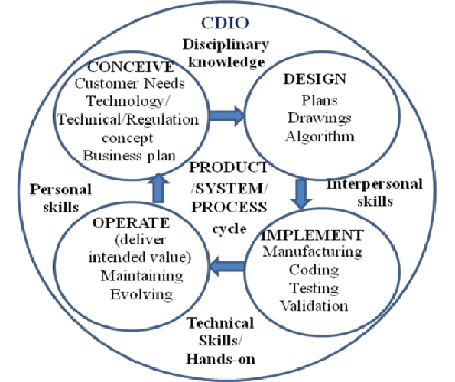
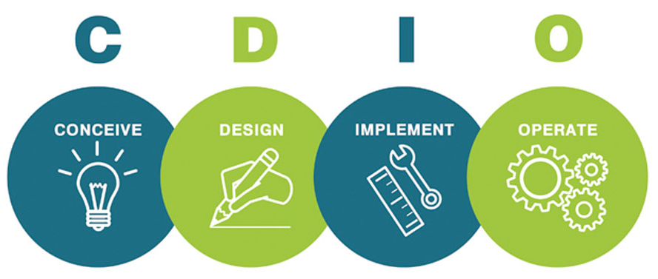
CDIO ENGINEERS IN INDUSTRY

Slide 13
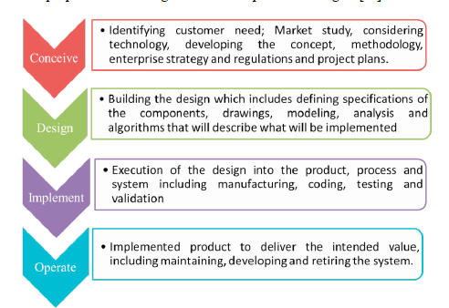
Conceive phase:
Defining customer needs;
Considering technology,
Enterprise strategy and regulations;
Developing concepts, techniques and
Business plans.
Design phase:
Creating the design;
Plans, drawings, and algorithms that describe what will be implemented.
Implement phase:
Transforming the design into the product, including manufacturing, coding, testing and validation.
Operate phase:
Using the implemented product to deliver the intended value, including maintaining, evolving and retiring the system.

Slide 14
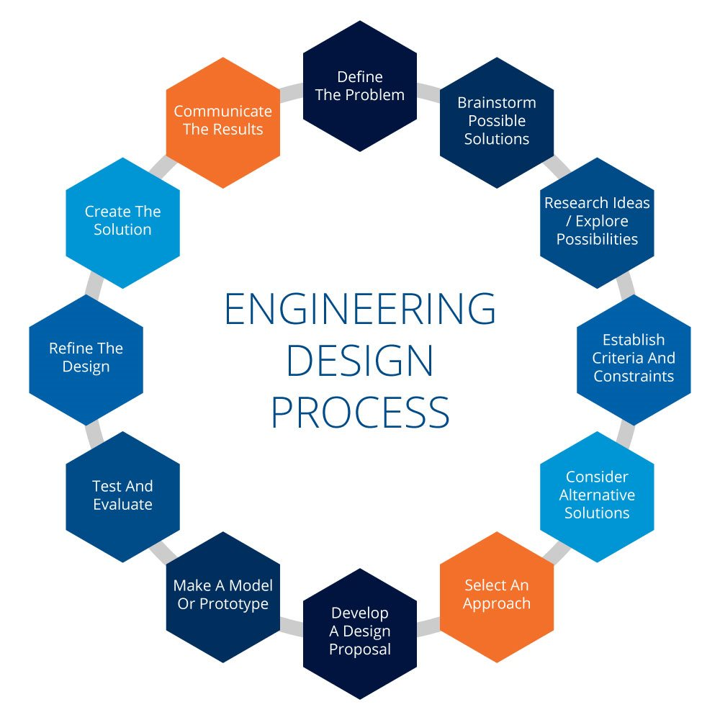
ENGINEERING DESIGN PROCESS
The engineering design process is a series of steps that engineers follow to find a solution to a problem. The steps include problem solving processes such as, for example, determining your objectives and constraints, prototyping, testing and evaluation.

Slide 15
Define The Problem – Engineers need to ask following questions:
What is the problem that needs to be solved?
Who is the design product for, and why is it important to find a solution?
What are the limitations and requirements?
Brainstorm Possible Solutions
Good designers brainstorm possible solutions before opting to start a design, building a list of as many solutions as possible.
It is best to avoid judging the designs and instead just let the ideas flow.
Research Ideas / Explore Possibilities for your Engineering Design Project
Use the experience of others to explore possibilities.
By researching past projects you can avoid the problems faced by others.
You should speak to people from various backgrounds, including users or customers.
You may find some solutions that you had not considered.
Establish Criteria and Constraints
Having listed potential solutions and determined the needs of the project alongside your research, the next step is to establish any factors that may constrain your work.
This can be done by revisiting the requirements and bringing together your findings and ideas from previous steps.

Slide 16
Consider Alternative Solutions
You may wish to consider further solutions to compare the potential outcomes and find the best approach.
This will involve repeating some of the earlier steps for each viable idea.
Select An Approach
Once you have assessed your various options you can determine which approach best meets your requirements.
Reject those that don’t meet your requirements.
Develop A Design Proposal
Having chosen your approach, the next step is to refine and improve the solution to create a design proposal.
This stage can be ongoing through the length of your project and even after a product has been delivered to customers.
Make A Model Or Prototype
Use your design proposal to make a prototype that will allow you to test how the final product will perform.
Prototypes are often made from different materials than the final version and are generally finished to a lesser standard.

Slide 17
Test And Evaluate
Each prototype will need testing, re-evaluation and improvement.
Testing and evaluation allows you to see where any improvements are needed.
Refine The Design
Once testing has been completed, the design can be revised and improved.
This step can be repeated several times as more prototypes are created and evaluated.
Create The Solution
After your refinements have been completed and fully tested, you can decide upon and create your finished solution.
This may take the form of a polished prototype to demonstrate to customers.
Communicate The Results
The final stage is to communicate your results.
This can be in the form of a report, presentation, display board, or a combination of methods.
Thorough documentation allows your finished product to be manufactured to the required quality standards.

Slide 18
OPERATIONAL FACTORS IN SYSTEM DESIGN
Integrity and Consistency
Application Performance Monitoring
Performance and Scalability
OPERATIONAL FACTORS IN SYSTEM DESIGN
Deployment Strategy
Unit Testing
Security
Recovery and Planning
User Experience and Inclusivity

Slide 19
Integrity and Consistency
The integrity of the data the system operates on is of the highest consideration when designing a reliable and fault-tolerant architecture.
The system should be designed to provide redundant backups that maintain data integrity and all-around consistency.
Performance and Scalability
Modern web applications are built to scale, and an elastic architecture that scales as the traffic grows ensures business needs are not impacted by a large customer base.
The architecture should encompass scalability approaches in the design, code, and infrastructure phases.
Deployment Strategy
A deployment process, whether in the cloud or on-premises, should be an integral part of the architecture design.
Deployment methodologies such as continuous integration and continuous deployment (CI/CD) should ideally be a fabric of this design to streamline the deployments of builds.

Slide 20
Security
In today’s world of ubiquitous and pervasive computing, a user’s sensitive information and overall data security is of paramount importance.
An architectural design should insist on incorporating security procedures as a pattern and enforce strong security practices via configuration or convention.
User Experience and Inclusivity
Pertinent to user-facing systems, the end-user experience is paramount in architecture design.
Experience architecture (XA) is the process of articulating the user’s journey from one subsystem to another within an application, and is vital in providing the user with helpful controls, hints, and other methods to navigate.
The system architecture should also include accessibility design as a part of the user experience, so they can navigate an application thoroughly regardless of physical or cognitive differences.

Slide 21
Recovery and Planning
Data recovery (DR) and business continuity planning (BCP) should be vital parts of an architectural design that ensures business needs are not largely affected when an unforeseen event occurs.
Unit Testing
A resilient architecture should incorporate unit testing as an essential component of its design.
A code coverage report generated on each build provides opportunities for code reviews within the team where any inconsistencies can be discovered quickly.
Automation should be explored as an integral element of the architecture wherever possible, and not as an afterthought.
Application Performance Monitoring
Even the best engineered systems fail.
The architecture should be robust enough to offer the end-users and
The development teams support information with what went wrong, when, and why.
Application performance monitors (APMs) are useful in providing detailed insights on application issues.

